Slide 1
65
Discrete Mathematics
Discrete Probability Practice

Slide 2





Slide 3




Slide 4






Slide 5






Slide 6


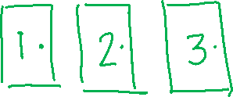











Slide 7
Up Next…
Probability Theory

